Slide 1
Predicting energy consumption pattern of HVAC using ML techniques
Ayan Nath
Ravikiran Anapagaddi
Rajat Nandan NS
Initial proposed title: Predicting optimum cooling air supply of room indoor environment using ML techniques

Slide 2
Introduction
Energy used by buildings worldwide is over 40%¹ of global energy consumption
Recently multiple building data are available from the diff. sensor data connected to building management systems
ML techniques can be analyzed to evaluate various sensor data and relate with its energy consumption pattern
These data/techniques can help to develop strategies for reducing energy consumption of buildings
Objective:
We want to analyze the energy consumption pattern of building using ML techniques
How to operate the HVACs to provide effective cooling by minimizing the energy consumption

Slide 3
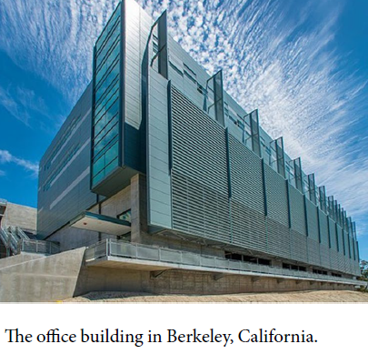
Explanation of raw dataset
3 years data set* for building is available which includes:
Whole-building and end-use energy consumption
HVAC system operating conditions
Indoor and outdoor environmental parameters
Occupant counts
Data | Description | No. of dataset | Sampling frequency
Energy use data | Miscellaneous electric load for North & South Wing | 2 | 15 min
 | Lighting load for the South Wing | 1 | 15 min
 | Heating Ventilation and Air Conditioning load for North & South Wing | 2 | 15 min
Outdoor environmental data | air temperature, Outdoor air dew temperature, air relative humidity, solar radiation | 5 | 15 min
Indoor environmental data | Cooling, Heating temperature setpoint of Zone * | 41+41 | 5 min
 | Zone temperature of interior, exterior zone | 16+51 | 10 min
 | CO2 concentration of each zone | 13 | 1 min
Occupant data | Occupant counts in south half of each floor | 2 | 10min
Wifi data | Wifi connection counts in the different building zones | 4 | 10min
HVAC operational data | Roof Top Unit operational characteristics (fan speed, Chilled water temp. etc) | 159 | 1 min
*Hong, Tianzhen; Luo, Na; Blum, David; Wang, Zhe (2022), A three-year building operational performance dataset for informing energy efficiency , Dryad, Dataset

Slide 4
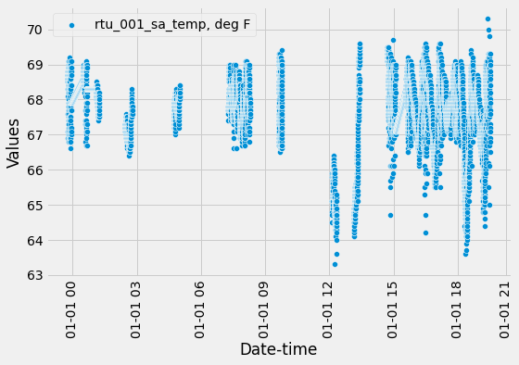
Challenges present in the dataset
Challenges
Data is missing for some ranges
Some data points were wrong
Temperature set points are not varying
All the HVAC systems are not operating continuously making complexity in the predictions
Data reaching max values
Missing data

Slide 5
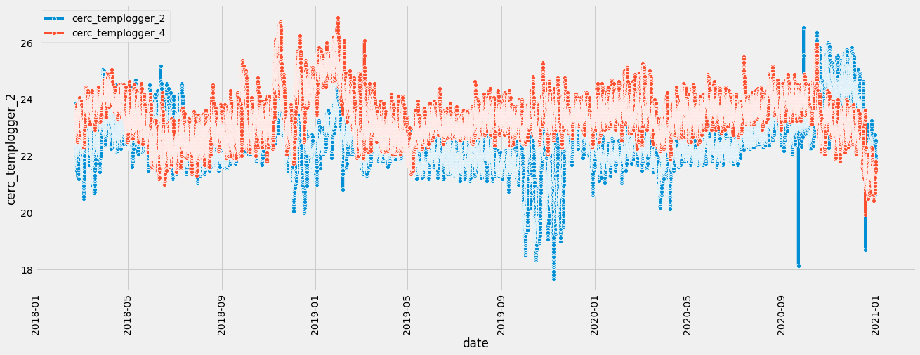
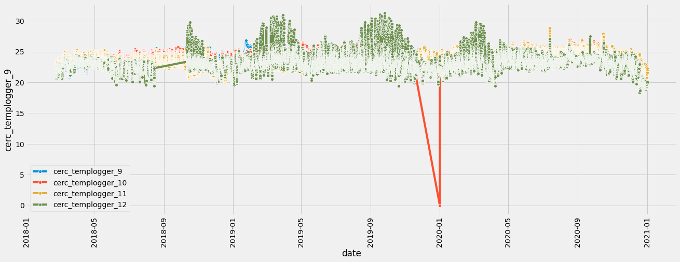
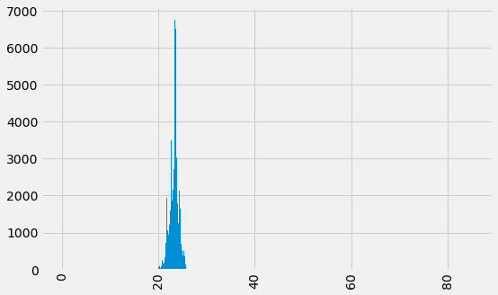
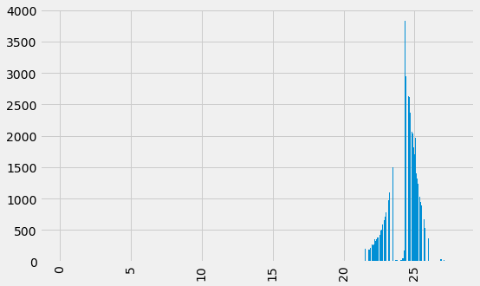
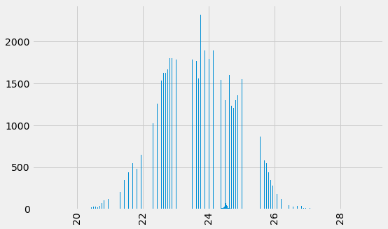
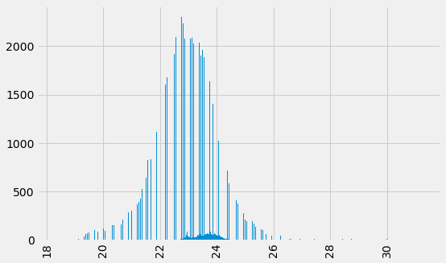
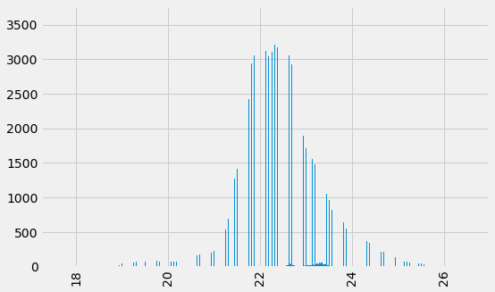
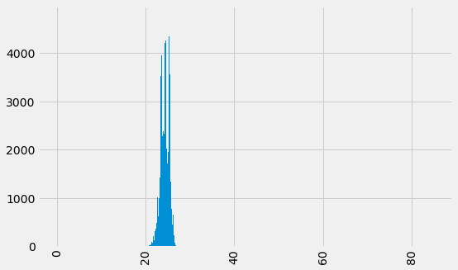
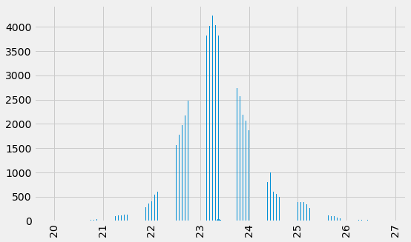
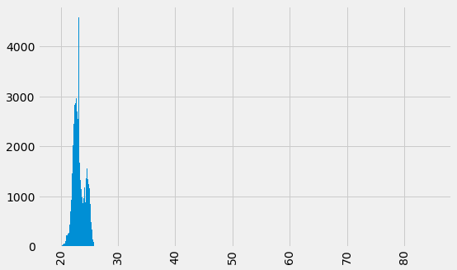
Visualizing the dataset: temp. pattern inside the building
cerc_templogger_3
Mean = 24.305298
Std = 1.085630
cerc_templogger_1
Mean = 23.245410
Std = 1.453204
cerc_templogger_2
Mean = 22.453918
Std = 0.899373
cerc_templogger_4
Mean = 23.364826
Std = 0.762841
cerc_templogger_9
Mean = 23.839946
Std = 1.020608
cerc_templogger_11
Mean = 23.752331
Std = 1.158243
cerc_templogger_10
Mean = 24.182938
Std = 0.970162
cerc_templogger_12
Mean = 22.955122
Std = 1.138486

Slide 6
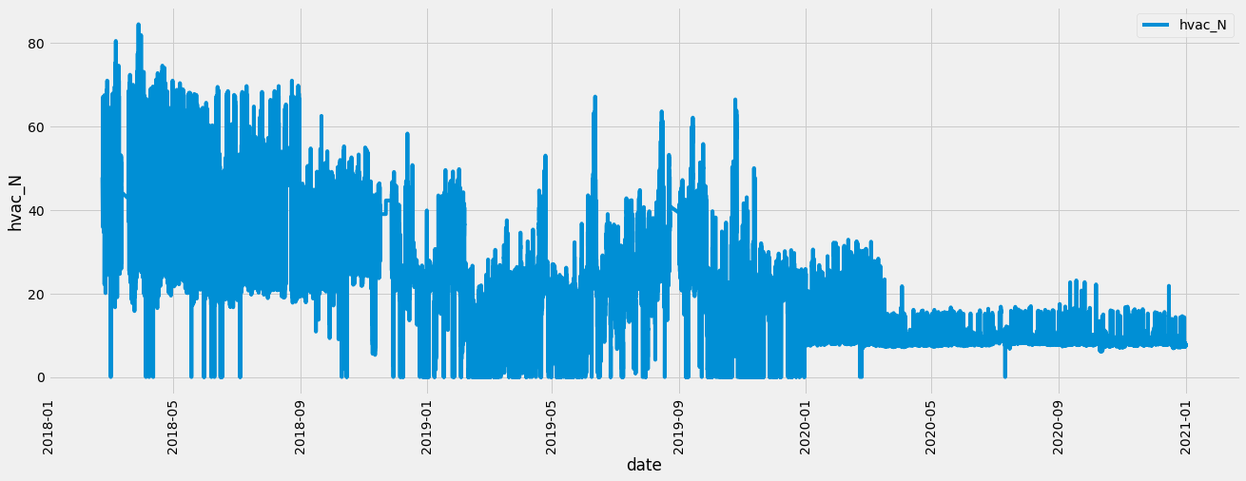
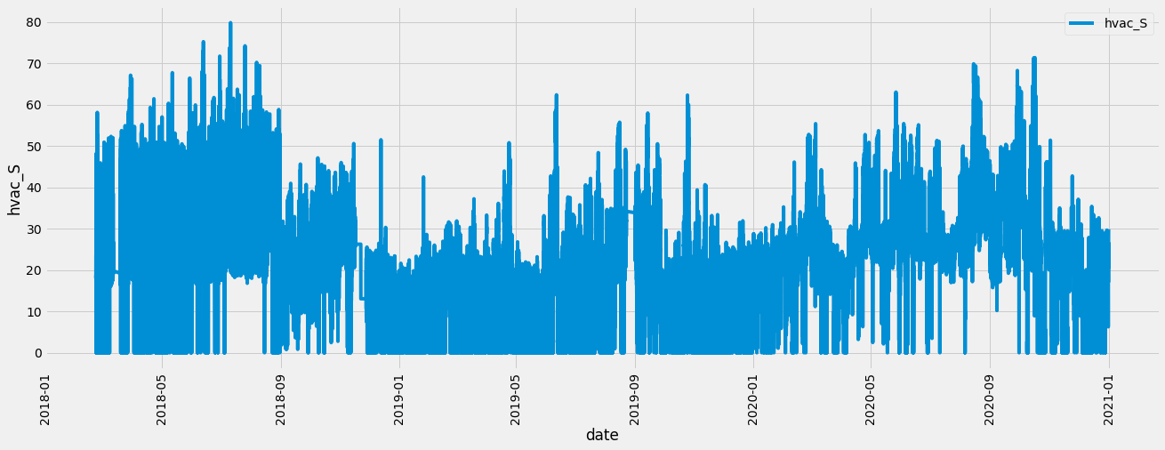
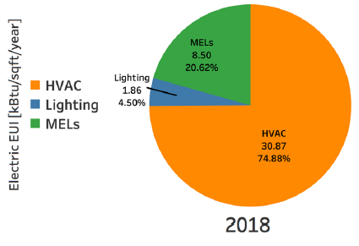
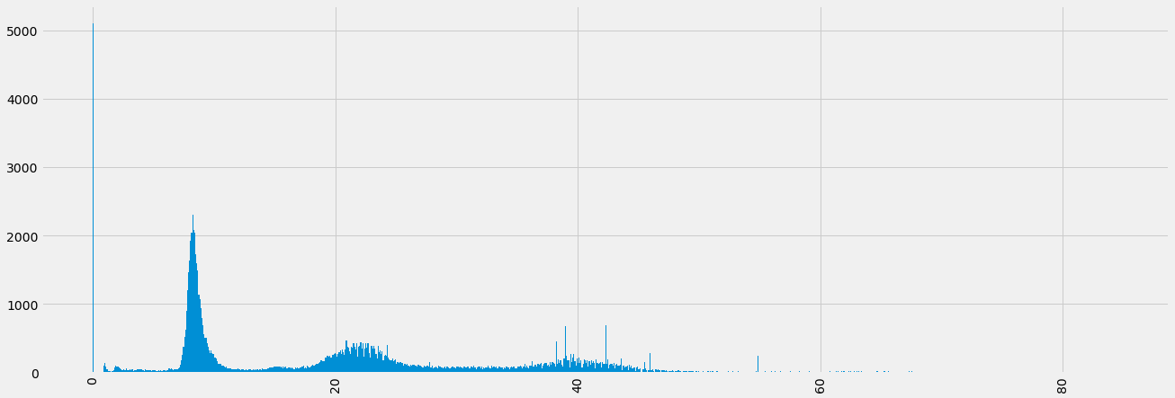
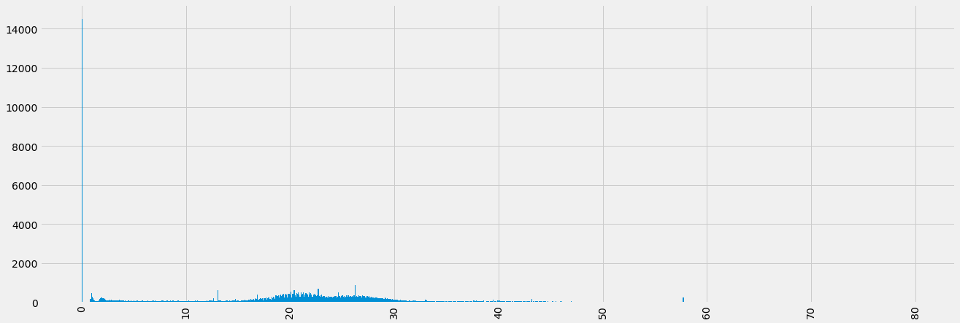
Energy consumption pattern of HVAC system
Most of the energy consumption in the building is contributed by HVAC system
hvac_N
Mean = 20.331573
Std = 14.1183
hvac_S
Mean = 19.53861
Std = 13.117456

Slide 7
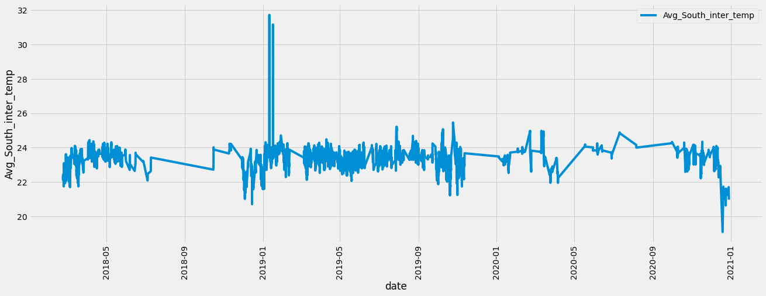
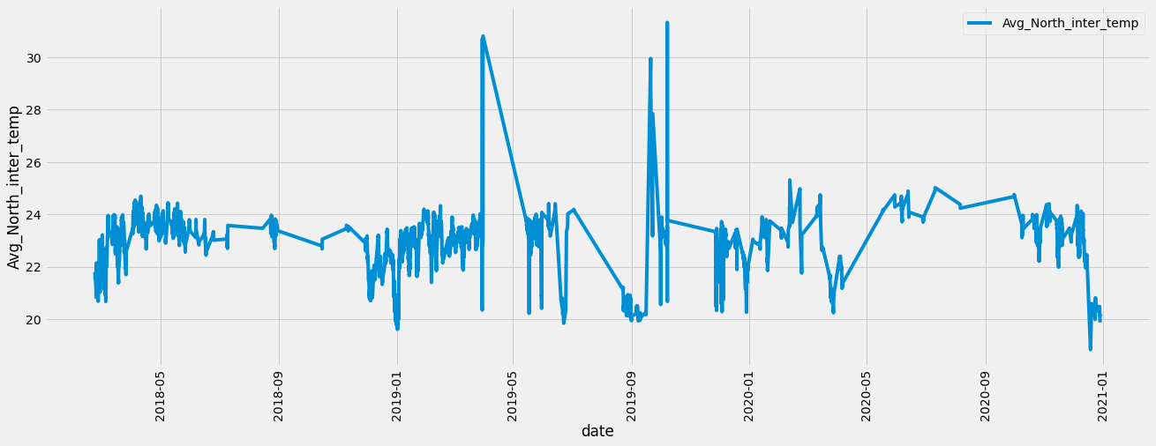
Relate the avg temp & HVAC energy consumtiotion:

Slide 8
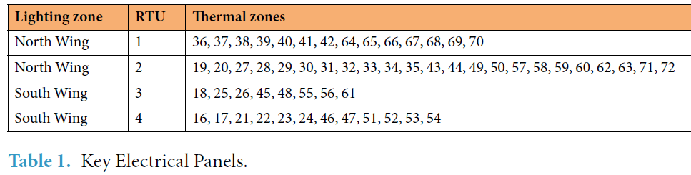
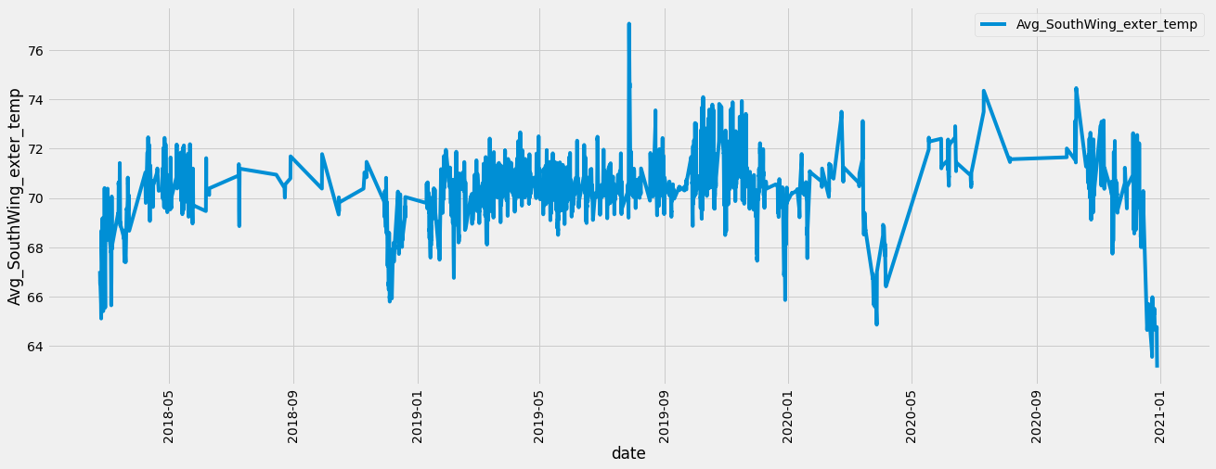

Slide 9
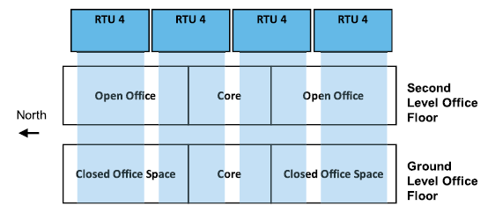
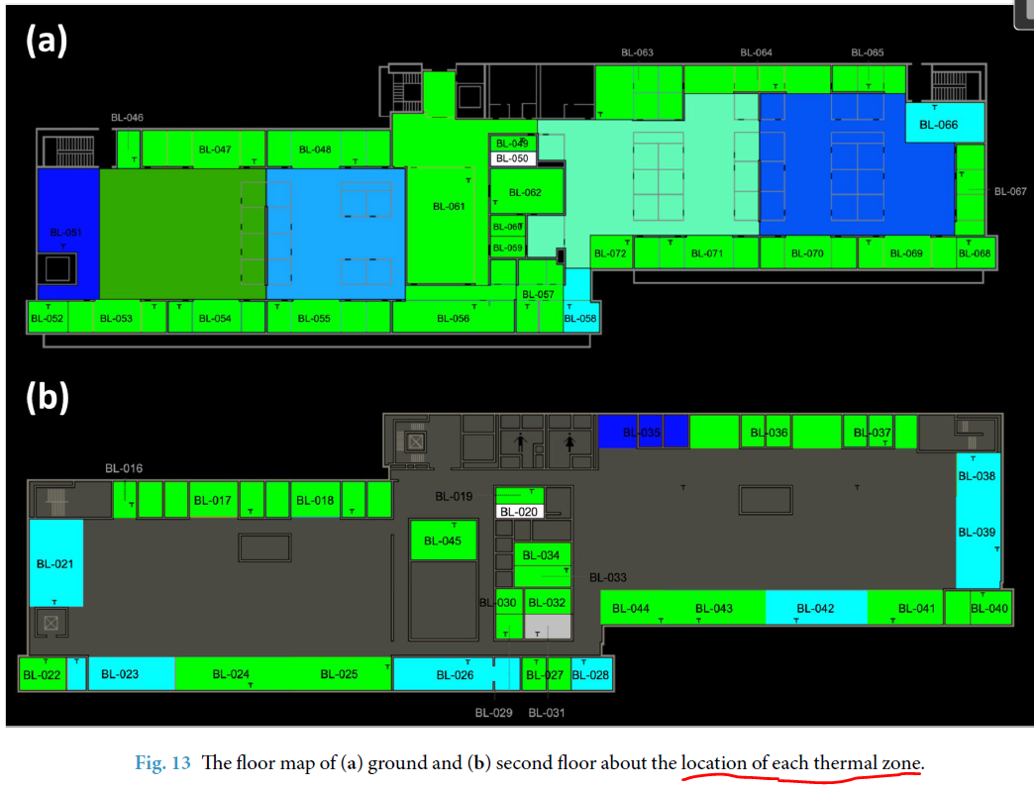
Correlate fan with multiple zone temp’s
RTU 1
RTU 2
RTU 3
RTU 4
Individual zone temp.
uft_fan_spd.csv | Supply air fan speed of Zone : 1,2,3,4
rtu_fan_spd.csv | supply fan speed : 1,2,3,4 return fan speed : 1, 2, 3, 4
rtu_sa_fr.csv | filtered supply air flow rate
rtu_oa_fr.csv | outdoor air flow rate
zone_temp_interior.csv
zone_temp_exterior.csv

Slide 10
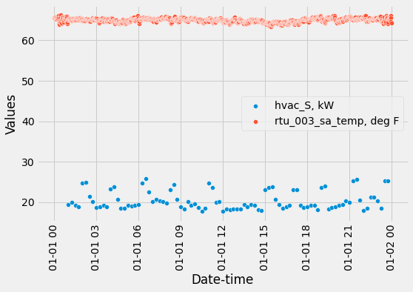
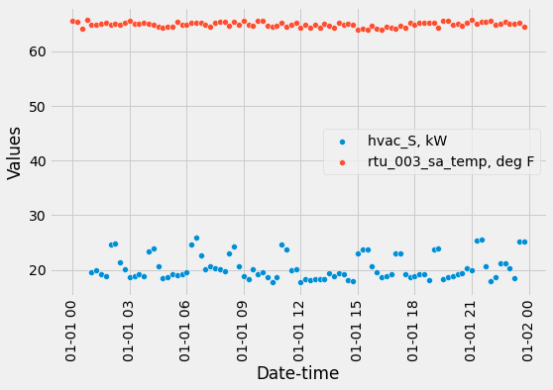
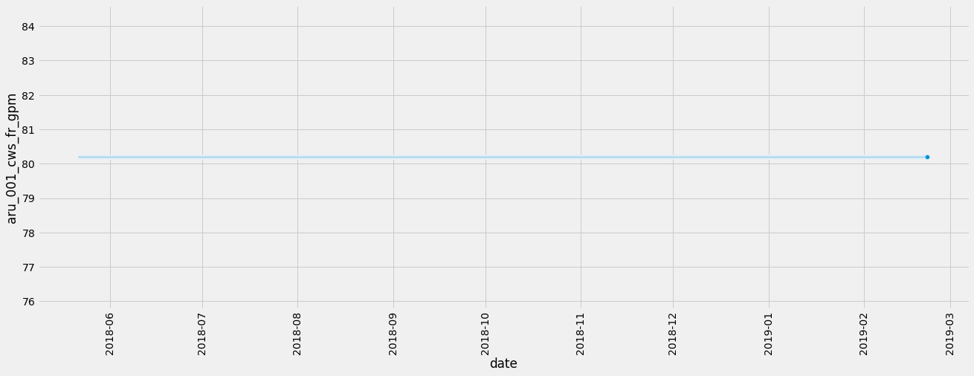
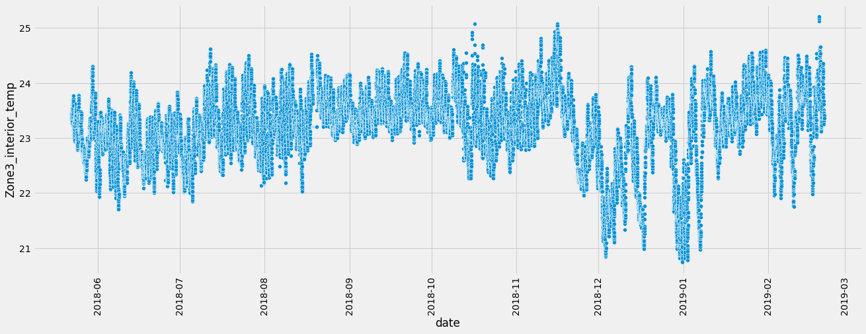
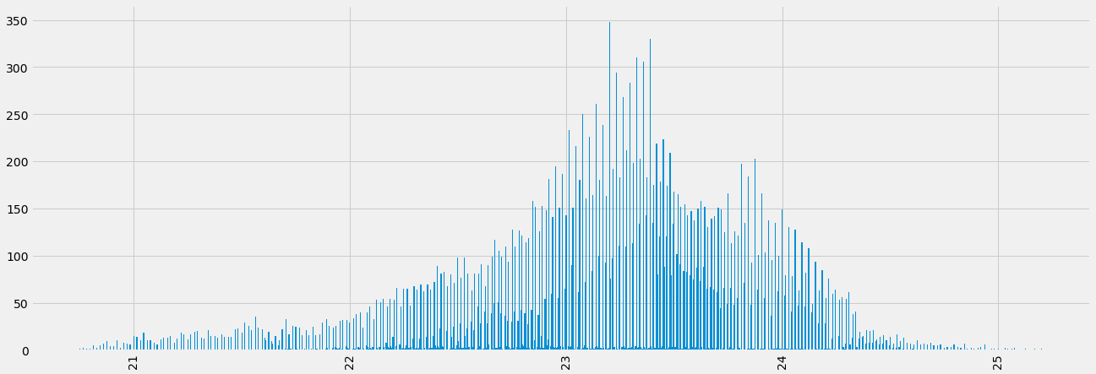
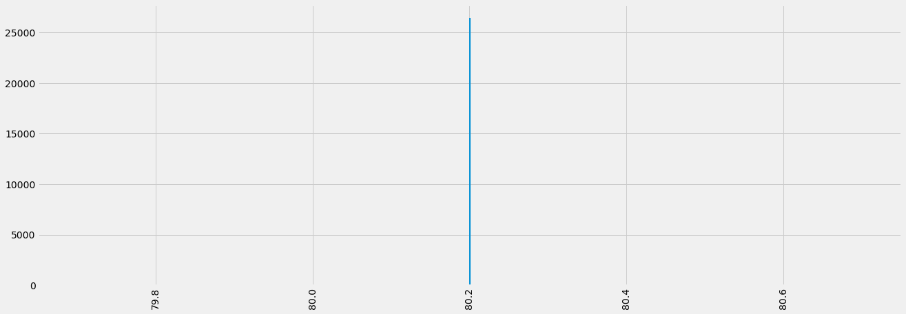
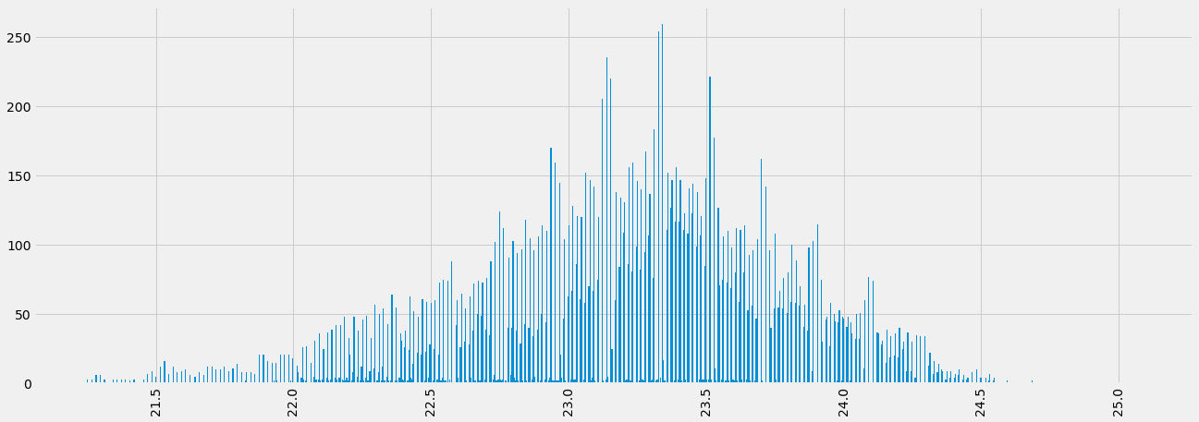
Data filtering
Sampling time: 1 min
Resampling data
15 mins interval
Resampling time: 15 mins
Sampling time: 15 mins
Resampling time: 15 mins
Zone3_interior_temp
Hot water flow rate
Mean = 23.207474
Std = 0.653814
3*Std
3*Std
Zone3_interior_temp
Calculate the stats and if the std is not changed much remove from the list
This signal has variability. And can not be removed
Outlier removed based on 3*sigma level
Zone3_interior_temp
Zone3_interior_temp
Hot water flow rate
Mean = 23.207474
Std = 0.653814
Mean = 23.21592
Std = 0.555608
Mean = 80.2
Std = 3.06E-11

Slide 11
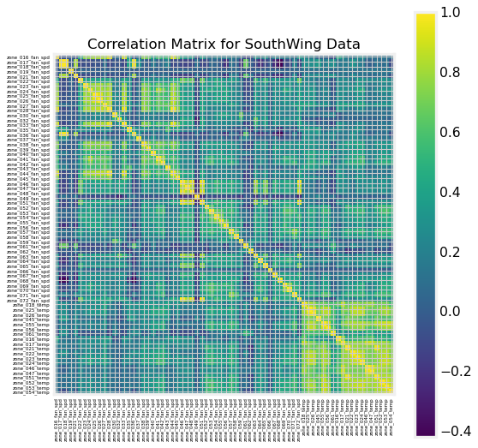

Slide 12
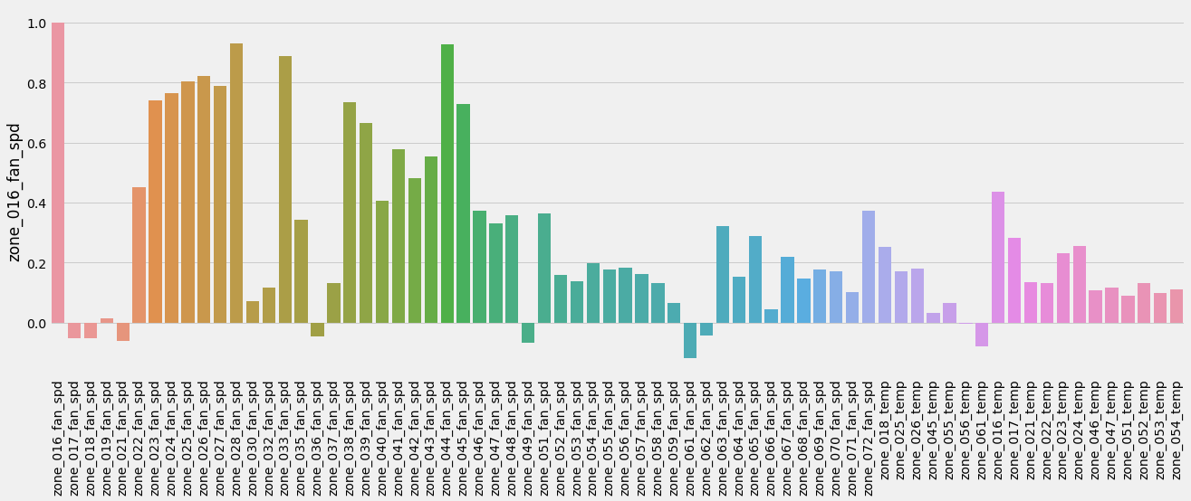
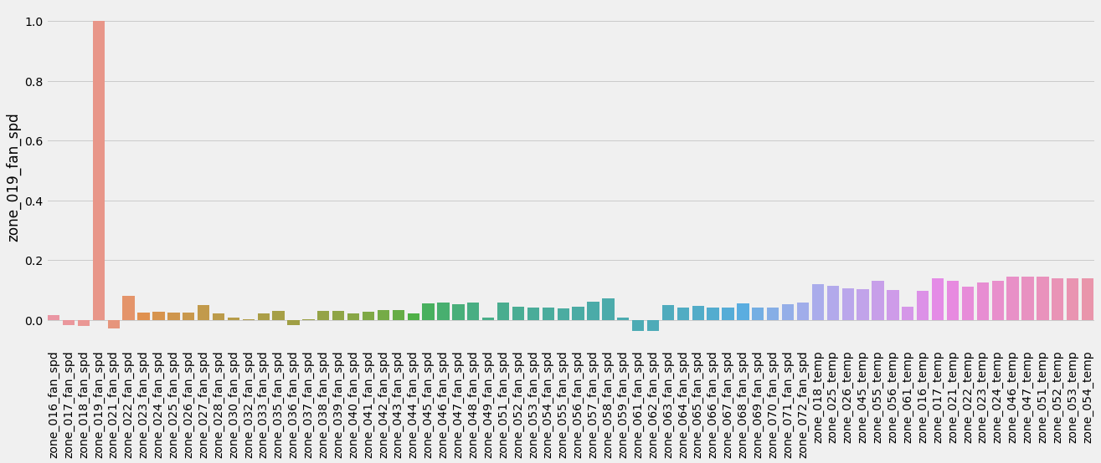
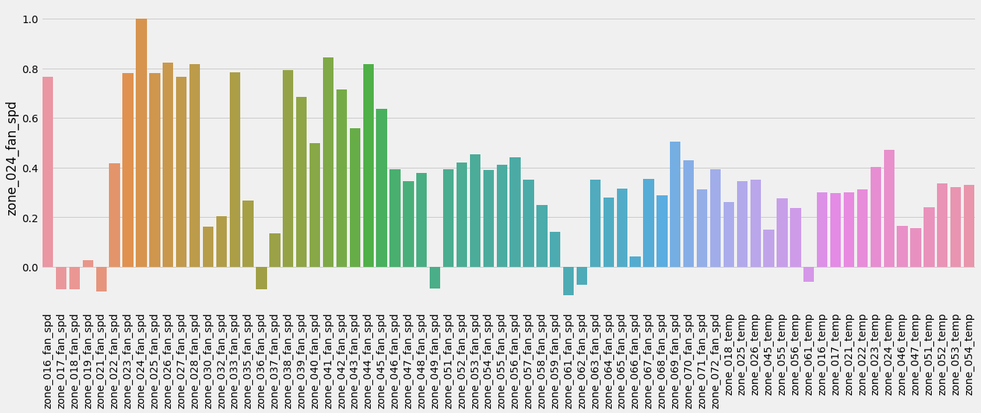
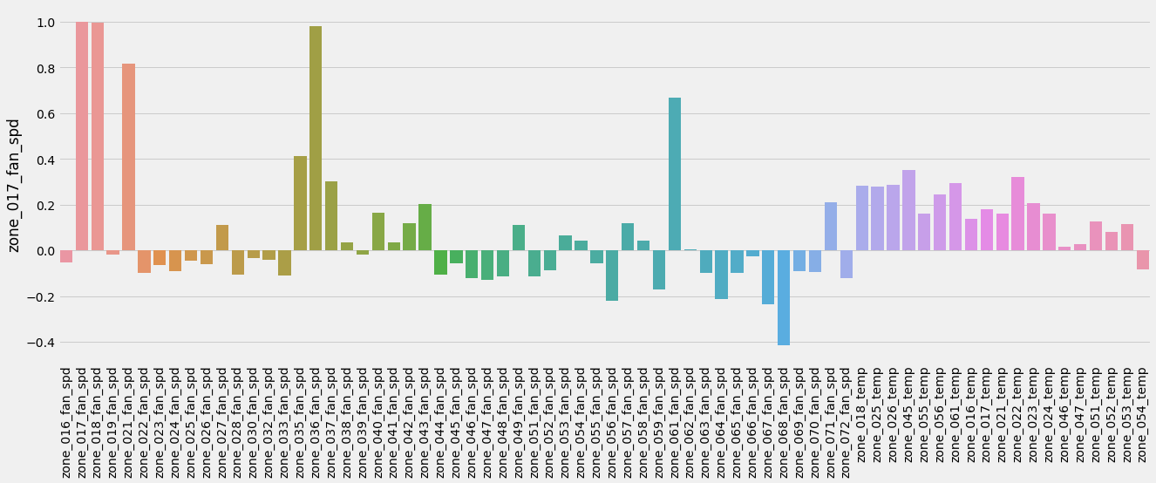
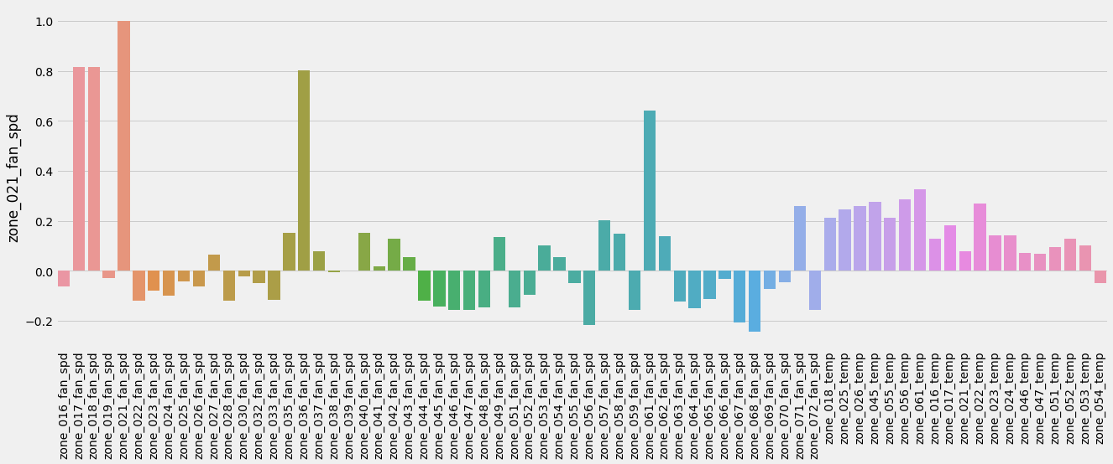
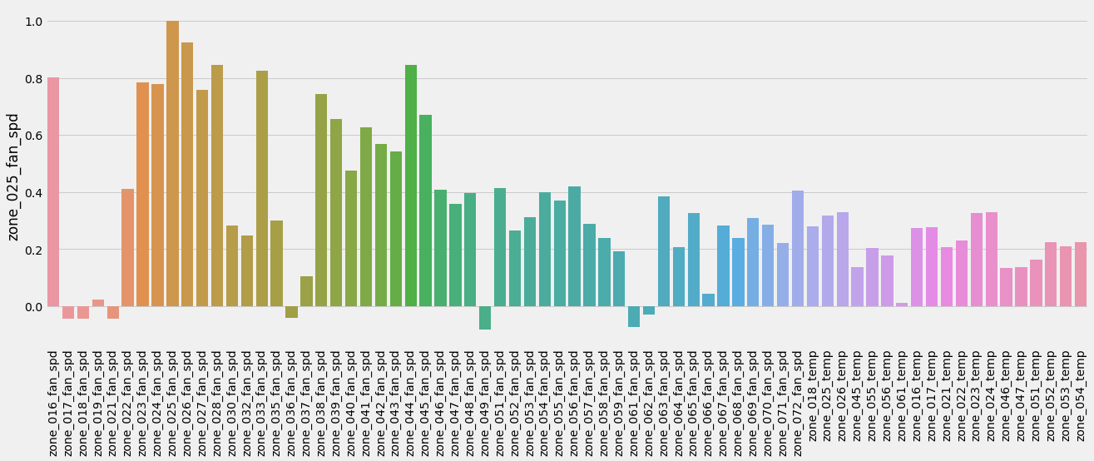

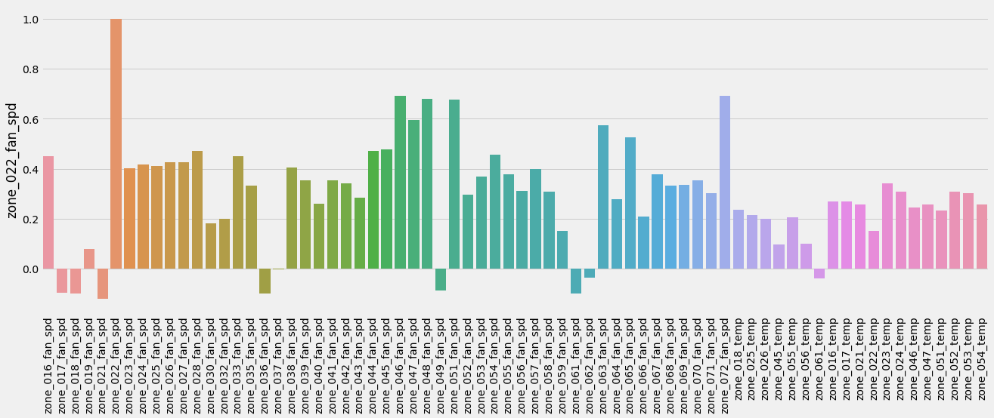
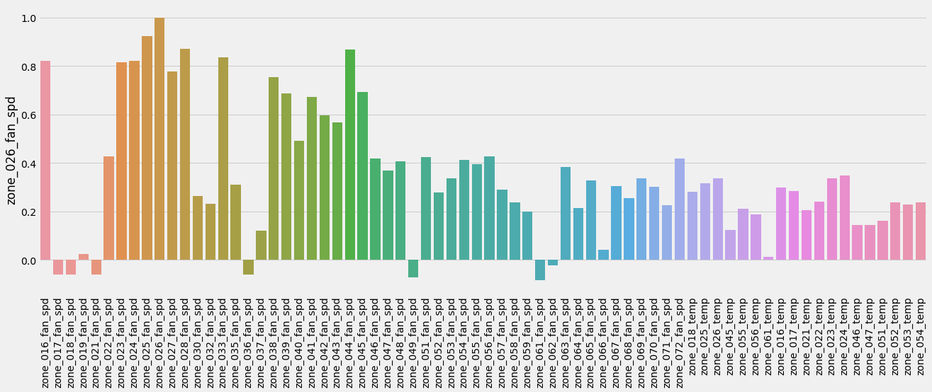

Slide 13
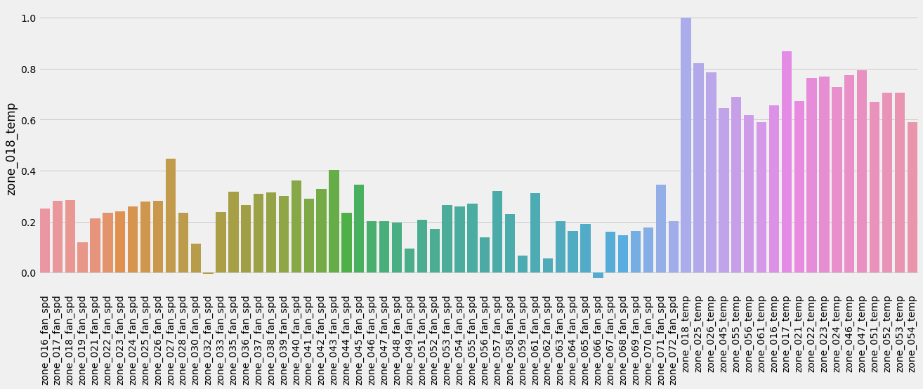
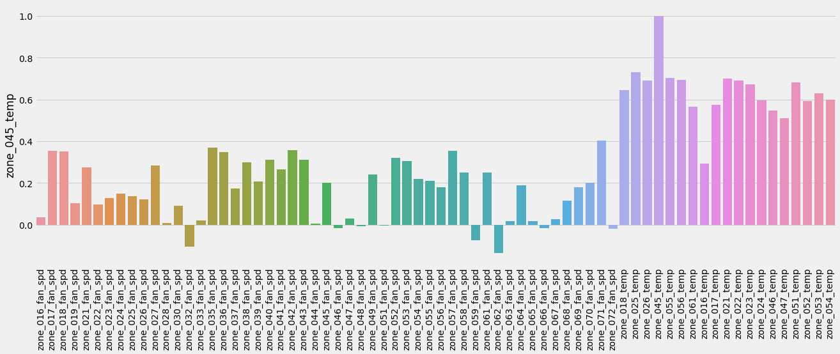
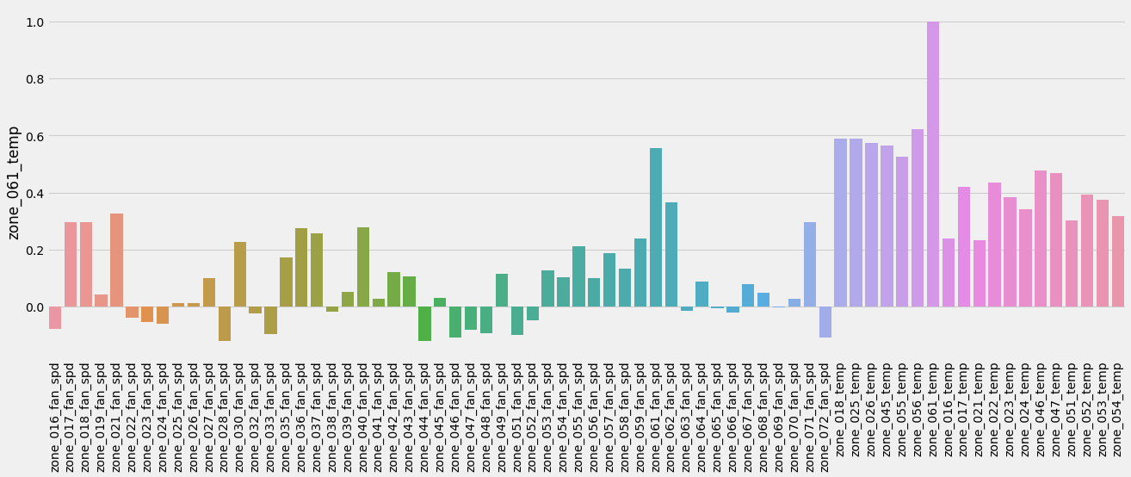
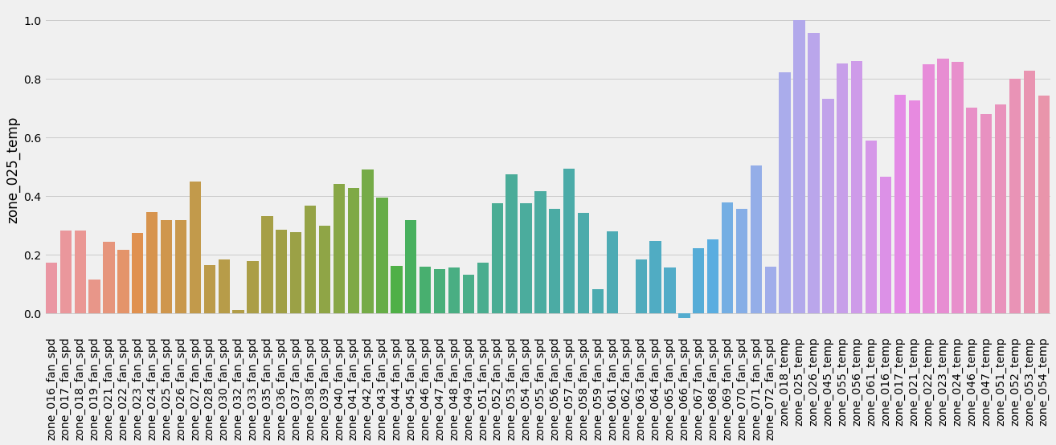
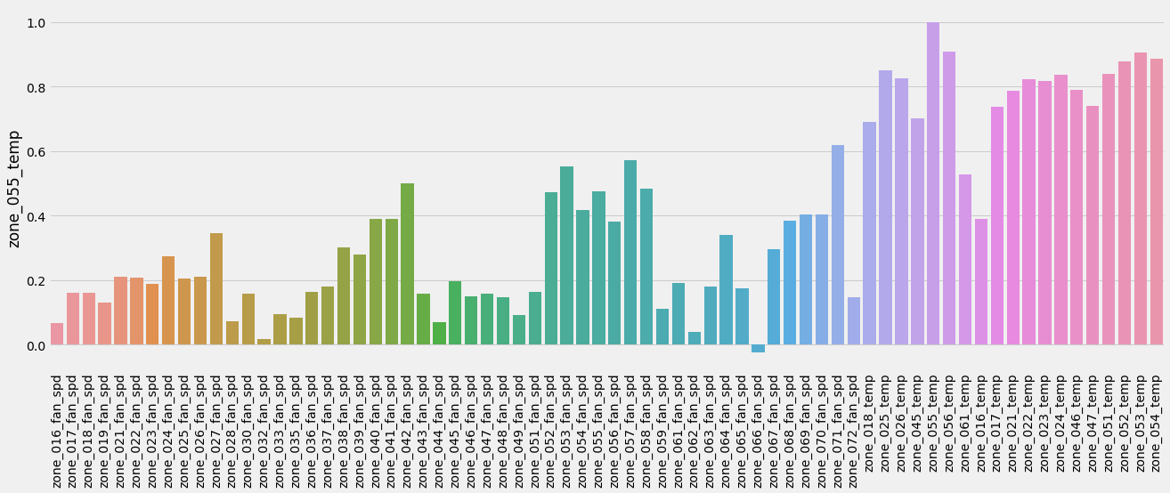
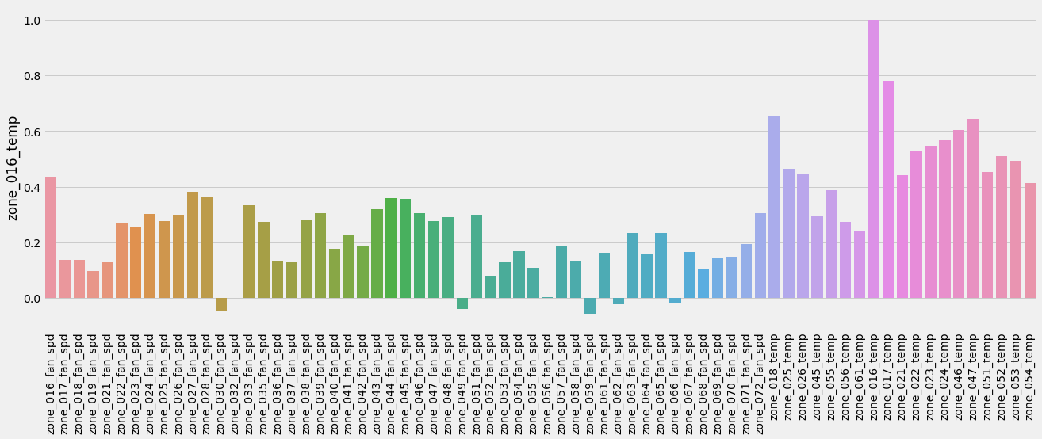

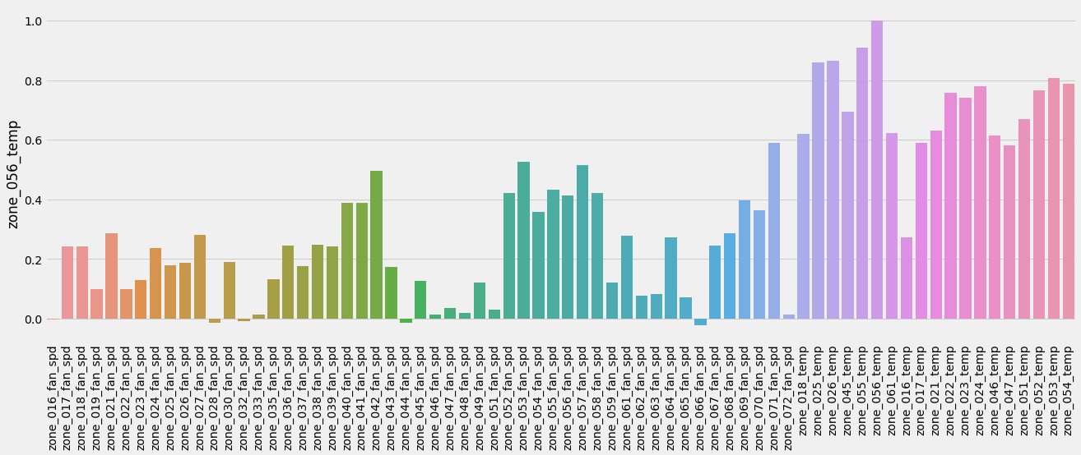
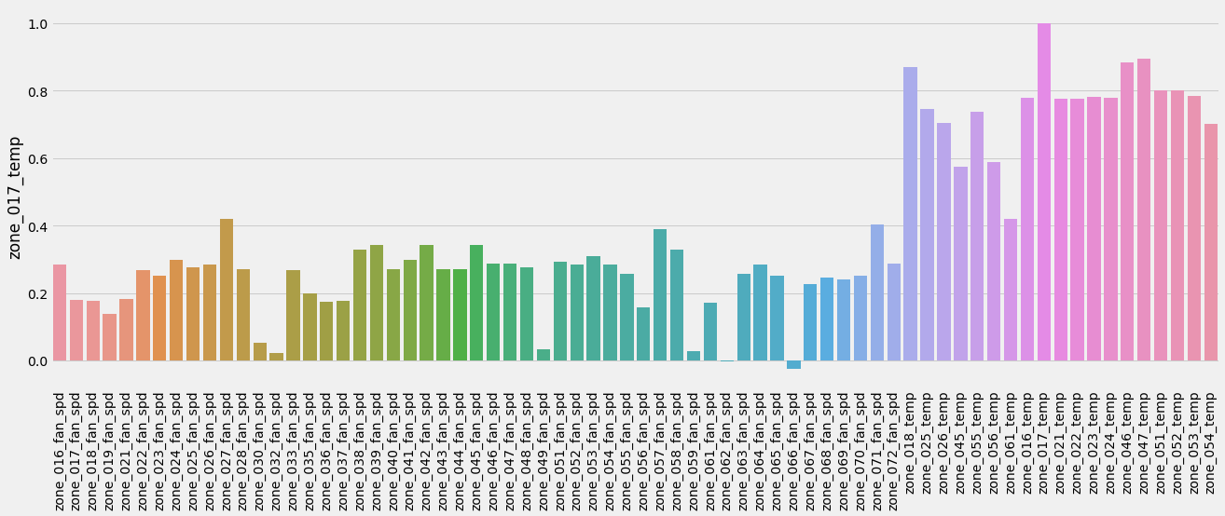

Slide 14
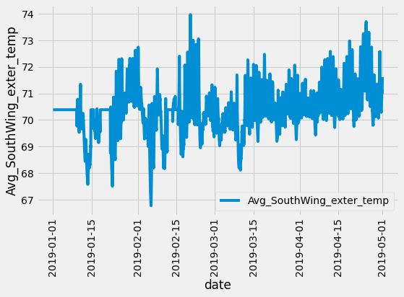
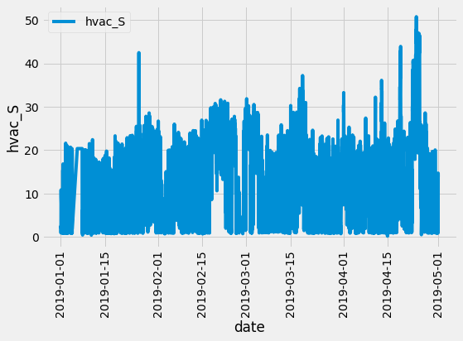
ML models: relation between Exterior temp and HVAC

Slide 15
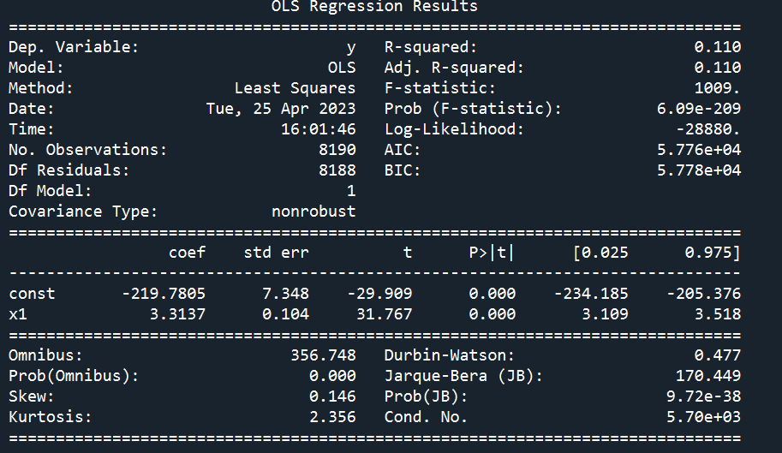



ML models: relation between Exterior temp and HVAC
Model 1
Model 2

Slide 16



ML models: relation between Exterior temp and HVAC

Slide 17



ML models: relation between (Exterior temp, interior temp) and HVAC

Slide 18



ML models: relation between (Exterior temp, interior temp) and HVAC

Slide 19



ML models: relation between (Exterior temp, interior temp) and HVAC

Slide 20


Extension of ML models
Performance of the ML model used

Slide 21

Improvements required to the ML model
Time dependency is an important factor for learning time-series data characteristics.
Suitable models for forecasting time series data:
Autoregressive Integrated Moving Average (ARIMA): It’s a statistical model for time series data analysis or predicting future trends
Moving Average: Uses previous forecast error rather than directly using previous values as in regression.
Exponential Smoothening: forecasting method only for univariate data
Long Short-Term Memory (LSTM) it’s a variety of Deep neural network model

Slide 22
References
Sensorless Air Flow Control in an HVAC System through Deep Learning, Junseo Son et. al. Appl. Sci. 2019, 9, 3293
Hong, Tianzhen; Luo, Na; Blum, David; Wang, Zhe (2022), A three-year building operational performance dataset for informing energy efficiency , Dryad, Dataset, https://doi.org/10.7941/D1N33Q
https://www.analyticssteps.com/blogs/introduction-time-series-analysis-time-series-forecasting-machine-learning-methods-models
https://builtin.com/data-science/time-series-forecasting-python

Slide 23
Thank you
Ayan Nath: ayannath23@gmail.com
Ravikiran Anapagaddi: rkiranmat@gmail.com
Rajat Nandan NS: rajat.nandan.ns@gmail.com

Slide 24

Relate Zone temp (18,25,..) 🡪 HVAC-3 flow rate

Slide 25


Target: Predict variation in fan speed forecasting using ML model
Relate fan speed with building occupancy & room temp.
Activity: Plotting – relating different variables
Average out to remove the missing data
ML model :
Outside air temp.
Occupant
Fan speed
Room temp
Multi-variable model

Slide 26


Slide 27


Slide 29



Slide 30
Data | File name | Column name | Description | Number of data points | Unit | Sampling frequency | Missing rate of the raw data (2018 - 2020) | Specific available time period (default is 3 years from 2018 to 2020)
HVAC operational data |  | hp_hws_temp.csv | Heat pump heating water supply temperature | 1 | °F | 1 min | 0.14
 |  | Roof Top Unit | Roof Top Unit * supply air temperature setpoint (*: 001, 002, 003, 004) | 4 | °F | 1 min | 0.15
 |  |  | Roof Top Unit * supply air temperature (*: 001, 002, 003, 004) | 4 | °F | 1 min | 0.14
 |  |  | Roof Top Unit * return air temperature (*: 001, 002, 003, 004) | 4 | °F | 1 min | 0.14
 |  |  | Roof Top Unit * mixed air temperature (*: 001, 002, 003, 004) | 4 | °F | 1 min | 0.14
 |  |  | Roof Top Unit * outdoor air temperature (*: 001, 002, 003, 004) | 4 | °F | 1 min | 0.14
 |  |  | Roof Top Unit * filtered supply air flow rate (*: 001, 002, 003, 004) | 4 | CFM | 1 min | 0.14
 |  |  | Roof Top Unit * outdoor air flow rate (*: 001, 002, 003, 004) | 4 | CFM | 1 min | 0.02 | Apr -- Dec 2020
 |  |  | Roof Top Unit * outdoor air damper position (*: 001, 002, 003, 004) | 4 | % | 1 min | 0.15
 |  |  | Roof Top Unit * economizer setpoint (*: 001, 002, 003, 004) | 4 | °F | 1 min | 0.14
 |  |  | Roof Top Unit * air pressure static setpoint (*: 001, 002, 003, 004) | 4 | psi | 1 min | 0.15
 |  |  | Roof Top Unit * plenum air pressure at floor ** (*: 001, 002, 003, 004; **: gnd_lvl, lvl2) | 8 | psi | 1 min | 0.14
 |  |  | Roof Top Unit * supply fan speed (*: 001, 002, 003, 004) | 4 | % | 1 min | 0.14
 |  |  | Roof Top Unit * return fan speed (*: 001, 002, 003, 004) | 4 | % | 1 min | 0.14
 |  |  | Heat meter for air source heat pump | 1 | mbtuph | 5 min | 0.29 | Aug -- Dec 2020
 |  | Chilled water | Chilled water supply temperature | 1 | °F | 5 min | 0.01
 |  |  | Chilled water return temperature | 1 | °F | 5 min | 0.01
 |  |  | Chilled water fow rate | 1 | CFM | 5 min | 0.02
 |  | Hot water | Hot water supply temperature | 1 | °F | 5 min | 0.16 | Oct 2019 -- Dec 2020
 |  |  | Hot water return temperature | 1 | °F | 5 min | 0.16
 |  |  | Hot water fow rate | 1 | CFM | 5 min | 0.01
 |  | Supply air fan speed | Supply air fan speed of Zone * | 44 | % | 1 min | 0.15-0.23
 |  |  | Heating water valve position of Zone * | 51 | % | 1 min | 0.15-0.25

Slide 31
Multivariate Multi-Step Time Series Forecasting Models
Time Series Analysis and Forecasting with Python – single variable
https://towardsdatascience.com/an-end-to-end-project-on-time-series-analysis-and-forecasting-with-python-4835e6bf050b
https://machinelearningmastery.com/how-to-develop-machine-learning-models-for-multivariate-multi-step-air-pollution-time-series-forecasting/

Slide 32



Sample slides:

Slide 45


Slide 46
Introduction
Worldwide building consumes lot of energy and contributes to emissions
Recently multiple building data are available from the diff. sensor data connected to building management systems
ML techniques can be analyzed to evaluate various sensor data and relate with its energy consumption pattern
These data/techniques can help to develop strategies for reducing energy consumption of buildings
Objective:
We want to analyze the energy consumption pattern of building using ML techniques

Slide 47
Visualizing the dataset: Hvac power consumption
hvac_N
Mean = 20.331573
Std = 14.1183
hvac_S
Mean = 19.53861
Std = 13.117456
Data shows most of the energy consumption in the building is contributed by HVAC system

Slide 48

Plan for using ML model
RTU 1
RTU 2
RTU 3
RTU 4
Relate energy consumption of HVAC with temp. data

Slide 49
Improvements required to the ML model
Time dependency is an important factor for learning time-series data characteristics.
Suitable models for forecasting time series data:
Autoregressive Integrated Moving Average (ARIMA): It’s a statistical model for time series data analysis or predicting future trends
Moving Average: Uses previous forecast error rather than directly using previous values as in regression.
Exponential Smoothening: forecasting method only for univariate data
Long Short-Term Memory (LSTM) it’s a variety of Deep neural network model

Slide 50
References
Hong, Tianzhen; Luo, Na; Blum, David; Wang, Zhe (2022), A three-year building operational performance dataset for informing energy efficiency , Dryad, Dataset, https://doi.org/10.7941/D1N33Q
https://www.analyticssteps.com/blogs/introduction-time-series-analysis-time-series-forecasting-machine-learning-methods-models
https://builtin.com/data-science/time-series-forecasting-python

